Slide 1
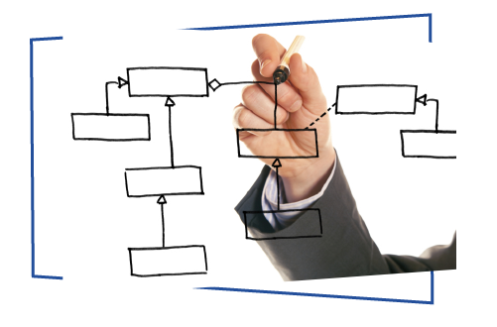
Demand Prediction
Saravana Ayyappa (Batch - DF1803)

Slide 2
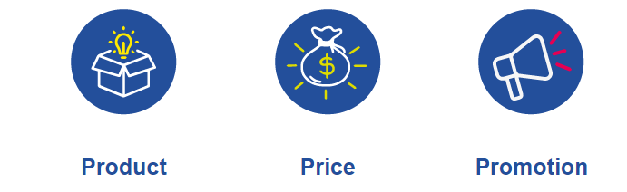
Market Mix Model
Impact of variables on marketing mix models
Developing an accurate forecast for sales is only possible by taking into account these main variables.

Slide 3
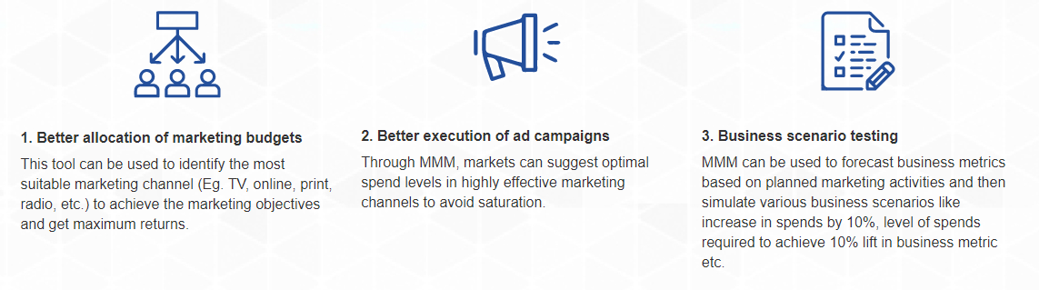
Importance of Marketing Mix Modelling

Slide 4
Variables Affecting Demand
1. Price: The price is a very significant factor. Price determines the target consumer group as well as the strategy for advertising, promotion and distribution.
2. Seasonality: Seasonality refers to variations that occur in a periodic manner. Seasonal opportunities are enormous, and often they are the most commercially critical times of the year. For example, major share of electronics sales are around the holiday season.
3. Marketing Campaigns: Marketing campaigns helps us to understand where the business needs to spend and how much to spend to increase the demand and sales

Slide 5
Auto-Regression
ARIMA is a time series model that uses observations from previous time steps as input to a regression equation to predict the value at the next time step.
The ARIMAX model is an extended version of the ARIMA model. It includes also other independent (predictor) variables.
Regularization of data
To achieve this balance, regularization is an important tool. Through regularization, you can add a penalty term to the objective function and control the model complexity completely using that penalty term

Slide 6

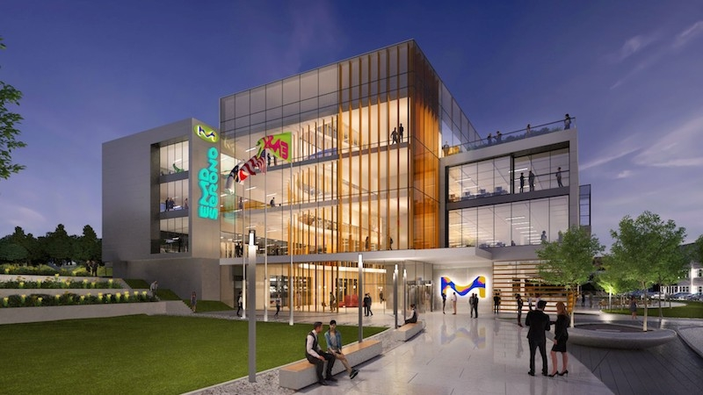
Dataset
Life Science Products, Services & Solutions - Merck India
Laboratory equipment refers to the various tools and equipment used by scientists working in a laboratory: The classical equipment includes tools such as Bunsen burners and microscopes as well as specialty equipment such as operant conditioning chambers, spectrophotometers and calorimeters.

Slide 7
Process
Exploratory Data Analysis and data cleaning
Transformation of independent & Dependent variables
Final Forecast
Verification of Model
LE_Units
LE_Visits
LE_Calls

Slide 8
Exploratory Data Analysis & data cleaning
Univariate of dependent as well as independent variables is done to test:
Quantity and quality of data (check for missing values)
Mean & Variance
Outliers
Inherent trends and seasonality

Slide 9
Exploratory Data Analysis & data cleaning
Treatment of missing values:
First check the reason for missing values, depending on which choose the treatment
If there are sufficient data points, missing values can be removed
If the variance is low, using mean is a good idea
Mean cannot be used in the case of high variance
Treatment of outliers:
First find if it needs to be treated. If they are intended to be high, then it should be left as it is. But knowing the outliers will help later in flagging them.
(+ or - 1.5*IQR) is a commonly used way to find outliers. \

Slide 10
Transformation of independent variables
Augmented Dickey-Fuller Test
While using ARIMA/ARIMAX to build a forecast model, one needs to make sure that the time series is stationary
This test is used to check whether the time series is stationary.
Here the null hypothesis (Ho) is that the data is non-stationary and the alternative hypothesis (H1) is that the data is stationary.
So, if the time series is non-stationary we can make it stationary by calculating ‘d’ using inverse ACF

Slide 11
Final Forecast
After creating the final dataset by accommodating for the seasonality and business changes through flags, the dataset is fed into R.
ARIMA/ARIMAX has been used throughout.
Now we run various iterations by trying different combinations of the variables depending upon their p values
The combination where all the independent variables are significant and the MAPE is minimum is used to forecast the dependent variable

Slide 12
Verification of Model
MAPE(Mean Absolute Percentage Error)
Here we find the error for previous data by taking the forecasted values
Then take the mean of the absolute value of the error

Slide 13
Variables used in the Model
CATEGORY | VARIABLES | METRICS
Price & SPends | Price Online | Price offered when Purchased Online
 | Margin Online | Margin received when sold Online
 | Price Offline | Price offered when Purchased Offline
 | Margin Offline | Margin received when sold Offline
 | Affiliate Marketing | Type of performance-based marketing in which a business rewards one or more affiliates for each visitor or customer brought by the affiliate's own marketing efforts.
 | Email Marketing | Email marketing is the act of sending a commercial email messages

Slide 14
Variables used in the Model
CATEGORY | VARIABLES | METRICS
Marketing Spends | Product Availability | Price Spent on Making the Product Available
 | Affiliates_L | Spends on Partner websites, Brand Management & Media – Lower Funnel
 | Search_L | Spends on Websites & Online Advertising – Lower Funnel
 | Affiliates_U | Spends on Partner websites, Brand Management & Media – Upper Funnel
 | Search_U | Spends on Websites & Online Advertising – Upper Funnel
 | Social_Media | Spends on Social Media Marketing

Slide 15
Variables used in the Model
CATEGORY | VARIABLES | METRICS
Business | Workshops | Various Workshops carried out regarding the new launces of products and services
 | TV_Marketing | Spends on TV Marketing
 | Mobile_Marketing | Spends on Mobile Marketing
 | Others | Other Expenses
 | Newspaper | Spends on Newspaper
 | Magazines | Spends on Magazines

Slide 16
Seasonality Flags
New- Year
Republic Day
Holi
Good-Friday
Labour Day
Eid-Ul-Fitar
Independence Day
Vinayaka Chaturthi
Dusshera
Diwali
Christmas

Slide 17
Business Findings
Media advertisements for the product has a positive coefficients in the model.
Heavy increase in Price is negatively affecting the Demand and Sales
There are negative as well as positive impact during various festival seasons
Strategy Management Can be based on the Output of the Time Series Model

Slide 18
Conclusions
We have identified how much variance Price is bringing in the Demand Cycle
Also we identified how various festivals are influencing the demand Positively & Negatively
Majorly we are able to find when to spend in each of the Marketing Activities & How much to spend to make better Sales in Each of our Channels.

